Slide 1


Networked Code Execution Platform
Group Member
Afaq Ahmad
Allah Rakha
Adnan Hussnain

Slide 2
Overview:
Decentralized P2P code execution platform
Based on Chord DHT algorithm
Nodes act as clients or code runners
Objectives :
Implement Chord protocol for distributed node management.
Enable seamless node joining and leaving.
Facilitate file transfer between nodes.
Execute Python code remotely on nodes.
Develop a GUI for visualizing and managing nodes.

Slide 3

Components:
Node
File Transfer Module
Represents a participant in the Chord ring.
Handles file sending and receiving.
Chord
Code Execution Module
Manages node joining, leaving, and lookup.
Executes Python code received from other nodes.

Slide 4
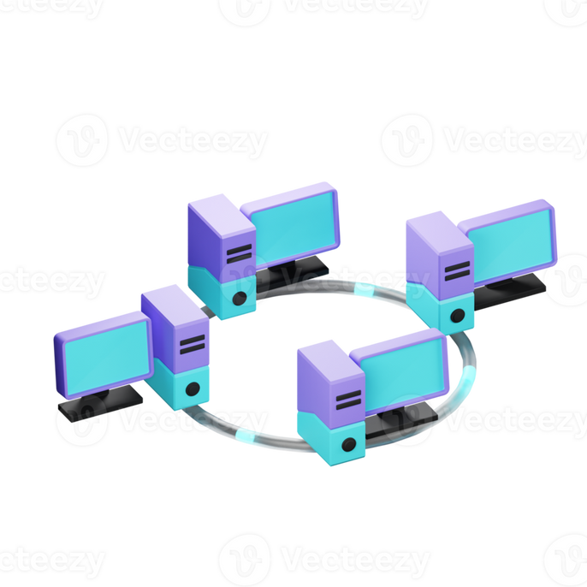
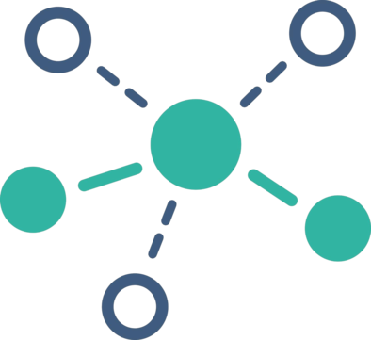
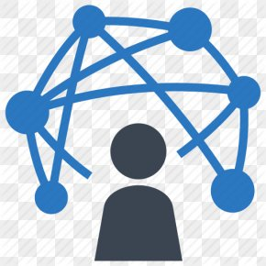
Chord Protocol
Chord Ring
Node Joining
Node Leaving
Uses consistent hashing to assign keys to nodes.
Each node is responsible for a specific range of keys.
New node identifies its location in the ring.
Updates finger tables of existing nodes.
Reassigns keys to successor nodes.
Updates finger tables to remove the departing node.

Slide 5

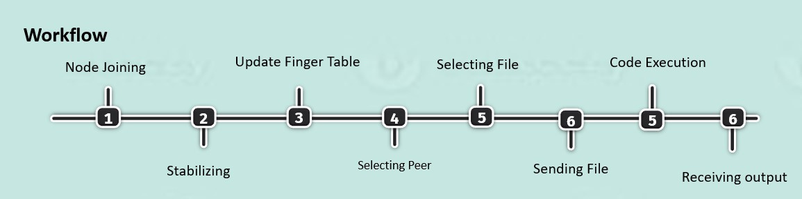
Workflow Diagram

Slide 6

Fault Tolerance
Informs predecessor and successor to update their references.
Node transfers its leeches to its successor.
Other nodes' finger tables may need updates to remove references to the leaving node.

Slide 7
Conclusion
In summary, our project presents a decentralized P2P platform for code execution, leveraging the Chord DHT algorithm for scalability and security. Moving forward, our focus remains on delivering a scalable, secure, and resilient solution for code execution needs.

Slide 8
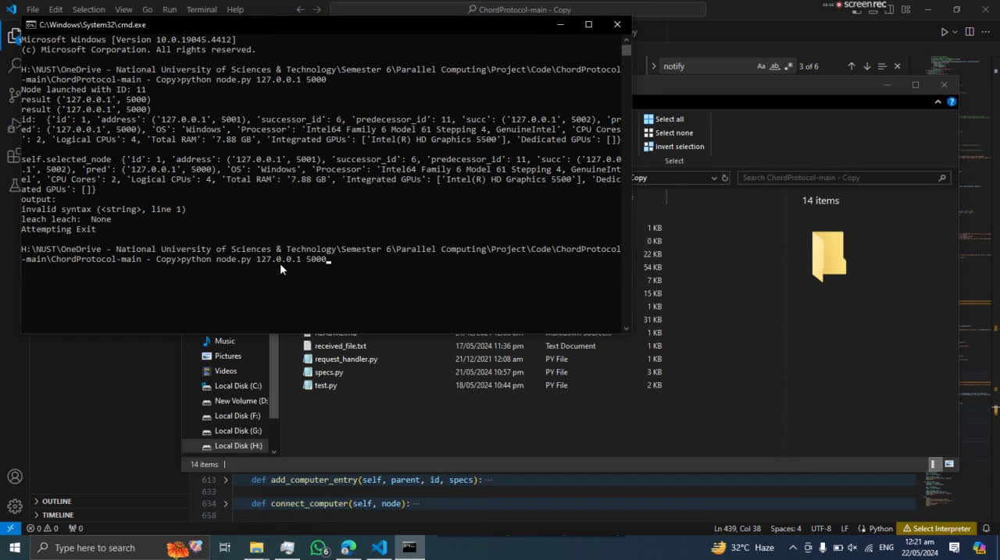
Demonstration

Slide 9
Thank you

